Slide 1
Advanced Deep Learning - Best Practices
Chapter 7

Slide 2
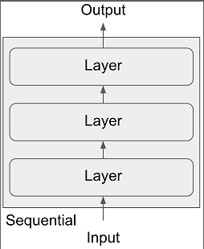
Keras Functional API
One input
One output

Slide 3
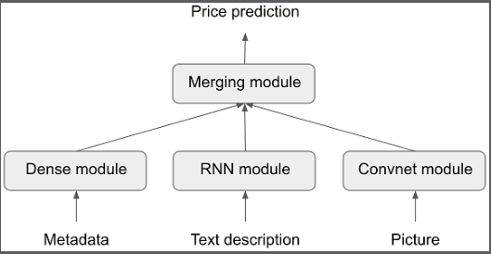
A Multi-Input Model

Slide 4
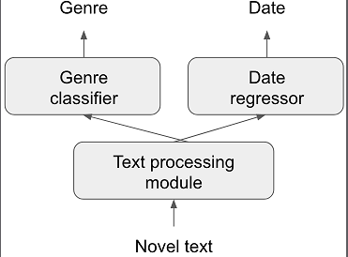
A Multi-Output Model

Slide 5
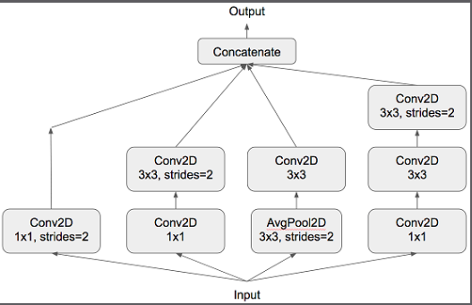
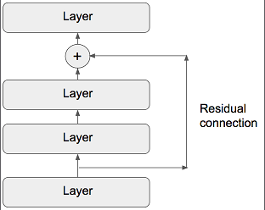
Inception and Residual Networks

Slide 6
API
seq_model <- keras_model_sequential() %>% ❶
layer_dense(units = 32, activation = "relu", input_shape = c(64)) %>%
layer_dense(units = 32, activation = "relu") %>%
layer_dense(units = 10, activation = "softmax")
input_tensor <- layer_input(shape = c(64)) ❷
output_tensor <- input_tensor %>%
layer_dense(units = 32, activation = "relu") %>%
layer_dense(units = 32, activation = "relu") %>%
layer_dense(units = 10, activation = "softmax")
model <- keras_model(input_tensor, output_tensor) ❸
summary(model) ❹”
Notes:
Excerpt From: François Chollet. “Deep Learning with R MEAP V01.” Apple Books.

Slide 7
Summary
“_________________________________________________________________
Layer (type) Output Shape Param #
=================================================================
input_1 (InputLayer) (None, 64) 0
_________________________________________________________________
dense_1 (Dense) (None, 32) 2080
_________________________________________________________________
dense_2 (Dense) (None, 32) 1056
_________________________________________________________________
dense_3 (Dense) (None, 10) 330
=================================================================
Total params: 3,466
Trainable params: 3,466
Non-trainable params: 0
Notes:
Excerpt From: François Chollet. “Deep Learning with R MEAP V01.” Apple Books.

Slide 8
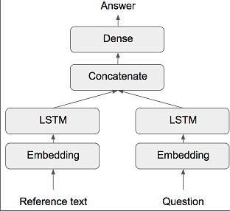
Multi-Input Model
text_vocabulary_size <- 10000
ques_vocabulary_size <- 10000
answer_vocabulary_size <- 500
text_input <- layer_input(shape = list(NULL), ❶
dtype = "int32", name = "text")
encoded_text <- text_input %>%
layer_embedding(input_dim = 64, output_dim = text_vocabulary_size) %>% ❷
layer_lstm(units = 32) ❸
question_input <- layer_input(shape = list(NULL), ❹
dtype = "int32", name = "question")
encoded_question <- question_input %>%
layer_embedding(input_dim = 32, output_dim = ques_vocabulary_size) %>%
layer_lstm(units = 16)
concatenated <- layer_concatenate(list(encoded_text, encoded_question)) ❺
answer <- concatenated %>% ❻
layer_dense(units = answer_vocabulary_size, activation = "softmax")
model <- keras_model(list(text_input, question_input), answer) ❼
“The text input is a variable-length sequence of integers. Note that you can optionally name the inputs.”

Slide 9
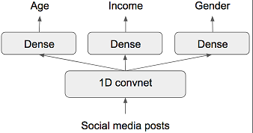
Multi-Output Model
Notes:
“model %>% compile(
optimizer = "rmsprop",
loss = c("mse", "categorical_crossentropy", "binary_crossentropy")
)
model %>% compile( ❶
optimizer = "rmsprop",
loss = list(
age = "mse",
income = "categorical_crossentropy",
gender = "binary_crossentropy"
)
)”
Excerpt From: François Chollet. “Deep Learning with R MEAP V01.” Apple Books.

Slide 10
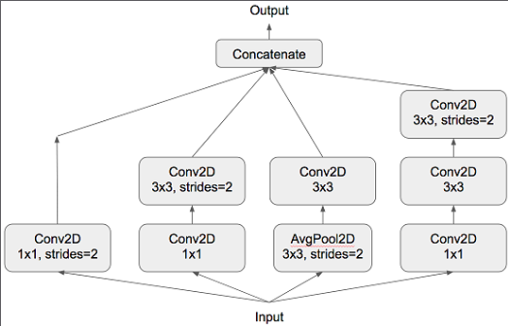
Directed Acyclic Graphs of Layers
branch_a <- input %>%
layer_conv_2d(filters = 128, kernel_size = 1,
activation = "relu", strides = 2) ❶
branch_b <- input %>%
layer_conv_2d(filters = 128, kernel_size = 1,
activation = "relu") %>%
layer_conv_2d(filters = 128, kernel_size = 3,
activation = "relu", strides = 2) ❷
branch_c <- input %>% ❸
layer_average_pooling_2d(pool_size = 3, strides = 2) %>%
layer_conv_2d(filters = 128, kernel_size = 3,
activation = "relu")
branch_d <- input %>%
layer_conv_2d(filters = 128, kernel_size = 1,
activation = "relu") %>%
layer_conv_2d(filters = 128, kernel_size = 3,
activation = "relu") %>%
layer_conv_2d(filters = 128, kernel_size = 3,
activation = "relu", strides = 2)
output <- layer_concatenate(list(
branch_a, branch_b, branch_c, branch_d
))
Notes:
”
Excerpt From: François Chollet. “Deep Learning with R MEAP V01.” Apple Books.

Slide 11
Residual Connections
output <- input %>% ❶
layer_conv_2d(filters = 128, kernel_size = 3,
activation = "relu", padding = "same") %>%
layer_conv_2d(filters = 128, kernel_size = 3,
activation = "relu", padding = "same") %>%
layer_conv_2d(filters = 128, kernel_size = 3,
activation = "relu", padding = "same")
output <- layer_add(list(output, input)) ❷
Notes:
❶
Applies a transformation to input
❷
Adds the original input back to output
”
Excerpt From: François Chollet. “Deep Learning with R MEAP V01.” Apple Books.

Slide 12
Models as Layers
xception_base <- application_xception(weights = NULL,
include_top = FALSE)
left_input <- layer_input(shape = c(250, 250, 3)) ❷
right_input <- layer_input(shape = c(250, 250, 3))
left_features = left_input %>% xception_base() ❸
right_features <- right_input %>% xception_base()
merged_features <- layer_concatenate( ❹
list(left_features, right_features)
)”

Slide 13
Inspecting and Monitoring Models
Using Callbacks
Model checkpointing—Saving the current weights of the model at different points during training.
Early stopping—Interrupting training when the validation loss is no longer improving (and of course, saving the best model obtained during training).
Dynamically adjusting the value of certain parameters during training—Such as the learning rate of the optimizer.
Logging training and validation metrics during training, or visualizing the representations learned by the model as they’re updated—The Keras progress bar that you’re familiar with is a callback!
Notes:
”
Excerpt From: François Chollet. “Deep Learning with R MEAP V01.” Apple Books.

Slide 14
Model Checkpoints and Early Stopping
“callbacks_list <- list( ❶
callback_early_stopping( ❷
monitor = "acc", ❸
patience = 1 ❹
),
callback_model_checkpoint( ❺
filepath = "my_model.h5", ❻
monitor = "val_loss", ❼
save_best_only = TRUE
)
)
model %>% compile(
optimizer = "rmsprop",
loss = "binary_crossentropy",
metrics = c("acc") ❽
)
model %>% fit( ❾
x, y,
epochs = 10,
batch_size = 32,
callbacks = callbacks_list,
validation_data = list(x_val, y_val)”

Slide 15
Reduce Learning Rate
callbacks_list <- list(
callback_reduce_lr_on_plateau(
“monitor = "val_loss", ❶
factor = 0.1, ❷
patience = 10 ❸
)
)
model %>% fit( ❹
x, y,
epochs = 10,
batch_size = 32,
callbacks = callbacks_list,
validation_data = list(x_val, y_val)

Slide 16
Tensorboard: The Tensor Visualization Framework
Visually monitoring metrics during training
Visualizing your model architecture
Visualizing histograms of activations and gradients
Exploring embeddings in 3D

Slide 17
“tensorboard("my_log_dir") ❶
callbacks = list(
callback_tensorboard(
log_dir = "my_log_dir",
histogram_freq = 1, ❷
embeddings_freq = 1, ❸
)
)
history <- model %>% fit(
x_train, y_train,
epochs = 20,
batch_size = 128,
validation_split = 0.2,
callbacks = callbacks”.

Slide 18
Getting the Most of your Models
Normalization
Layer_batch_normalization
batch_renormalization
Separable convolution
layer_separable_conv_2d

Slide 19
Hyperparameter Optimization

